Slide 1
Eat with Chef system
Group 6

Slide 2
Contents
Problem
Solution
Main Functions
Technology
Summary
Demo

Slide 3

Problem
Does not have enough time to prepare
Does not have experience to design
Want to daily flexible menu
Want to eat a good foods with family but…
Worry about food safety
Customer

Slide 4




Problem
Increase sale
Business owner want…
Customer relation ship

Slide 5
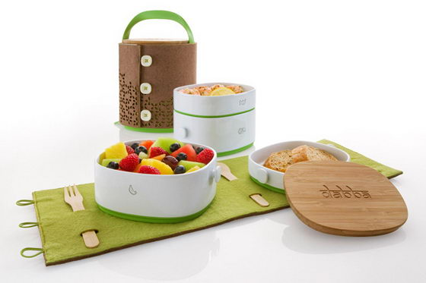


Problem
Design a good meal for customer
Chef want…
Share their cooking experience

Slide 6
Solution
Eat with chef

Slide 7

Solution
Business owner
Eat with chef
System
Customer
Chef

Slide 8
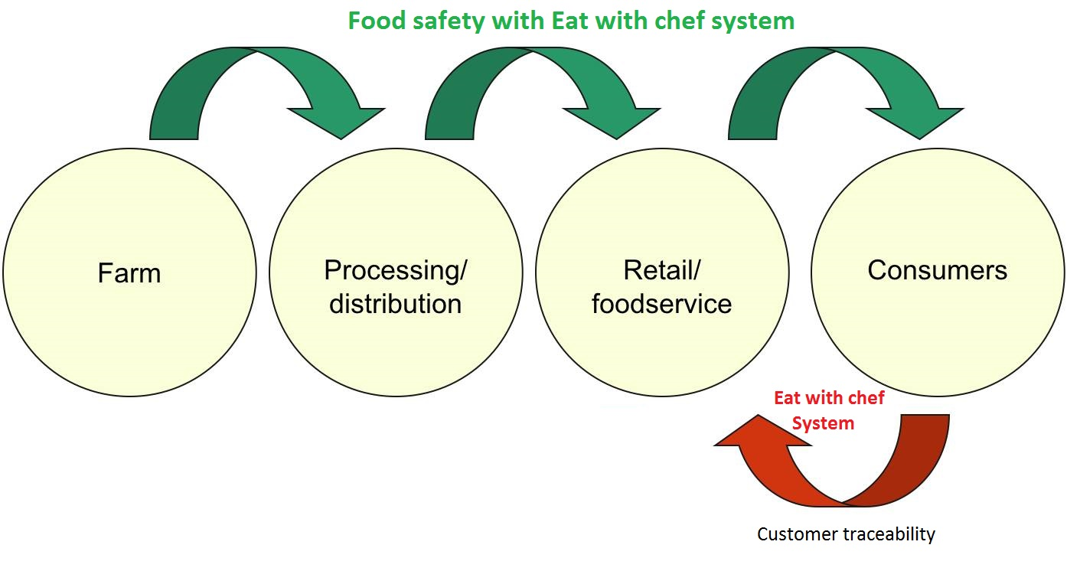
Solution

Slide 9
Solution
Ecommerce
Gaming
Social
Remarketing

Slide 10
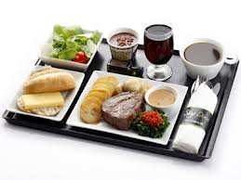

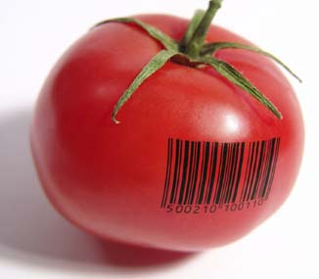
Main functions
Order dishes
Online payment
Customer
View ingredient traceability

Slide 11

Chef
Create dish produce session
Chef

Slide 12
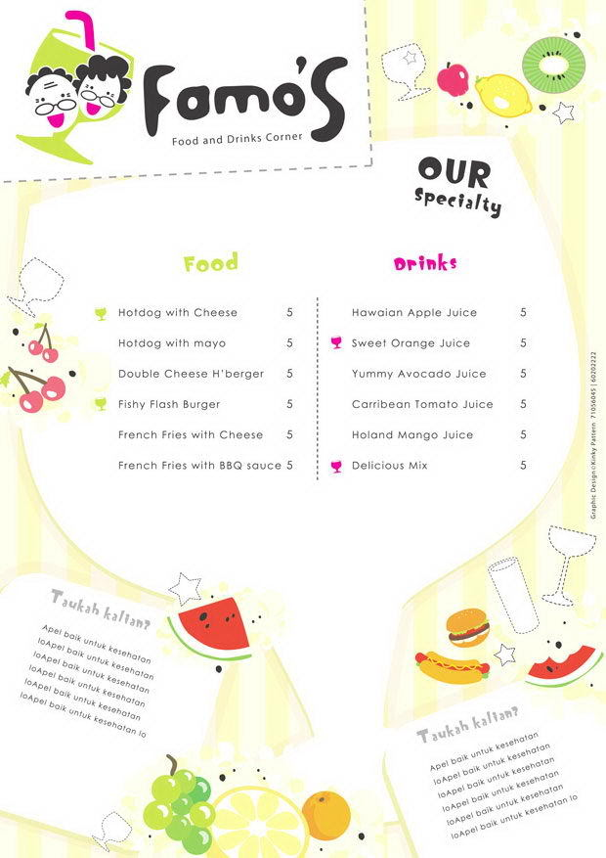

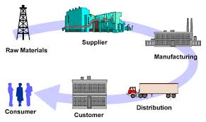
Staff
Publish daily menu
Manage supplier & Ingredient
Staff

Slide 13





Technology
Microsoft Team foundation server

Slide 14
Summary
Achievement
Customer can order dishes easily
Customer can view ingredient traceability by QR code and web
Customer can ask cooking question with chef
Staff can publish and manage flexible daily menu
Staff can manage orders easily
Chef can create produce session
Chef can answer cooking question
Limitation
Support only one payment method with Pay Pal
Does not support delivery system

Slide 15
Summary
Future plan
Develop delivery system.
Integrate more online payment methods
Implement gaming and more social for customer
Improve system performance
Improve system as user friendly as possible
Improve business concept

Slide 16
Q&A
Thanks for your listening

